Slide 1
Wordclouds in R
Lofty solutions for qualitative data

Slide 2
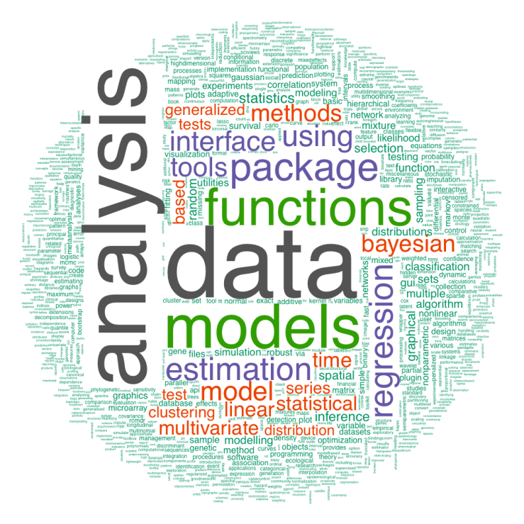
WORDCLOUDS
What is a word cloud?
A visual representation for text data
http://onertipaday.blogspot.com/2011/07/word-cloud-in-r.html

Slide 3
WORDCLOUDS
Required packages:
tm (text mining)
http://cran.r-project.org/web/packages/tm/tm.pdf
wordcloud
http://cran.r-project.org/web/packages/wordcloud/wordcloud.pdf

